Slide 1

Private school organiser
By Zhenya Yordanova, Ivan Ivanov,
Radoslav Stoychev and Magdalena Omayska

Slide 2
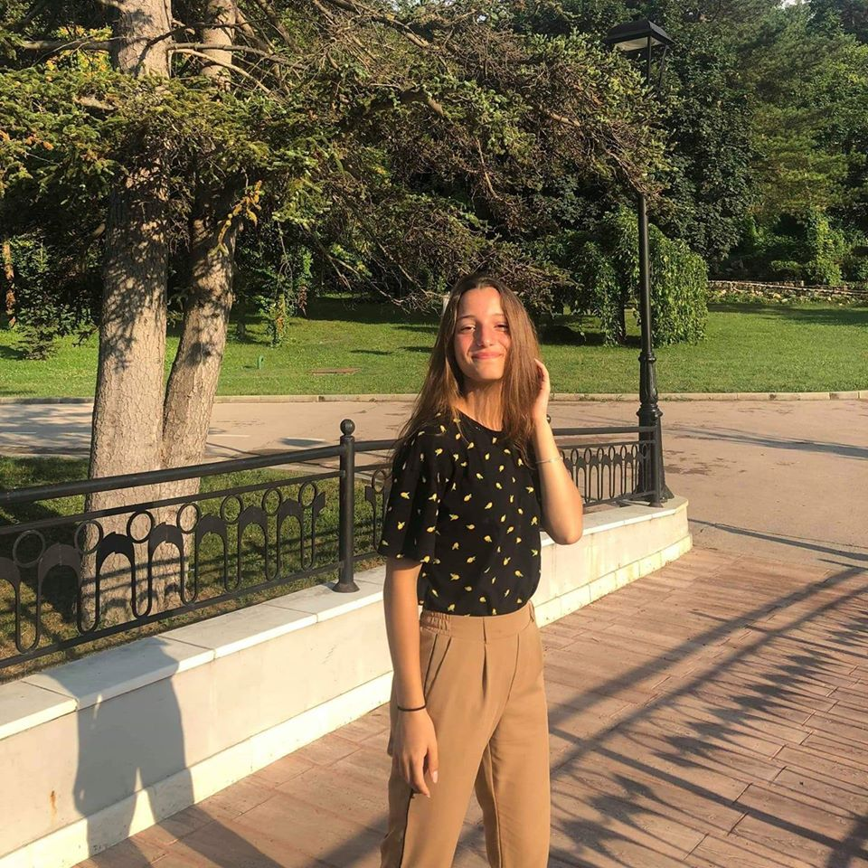
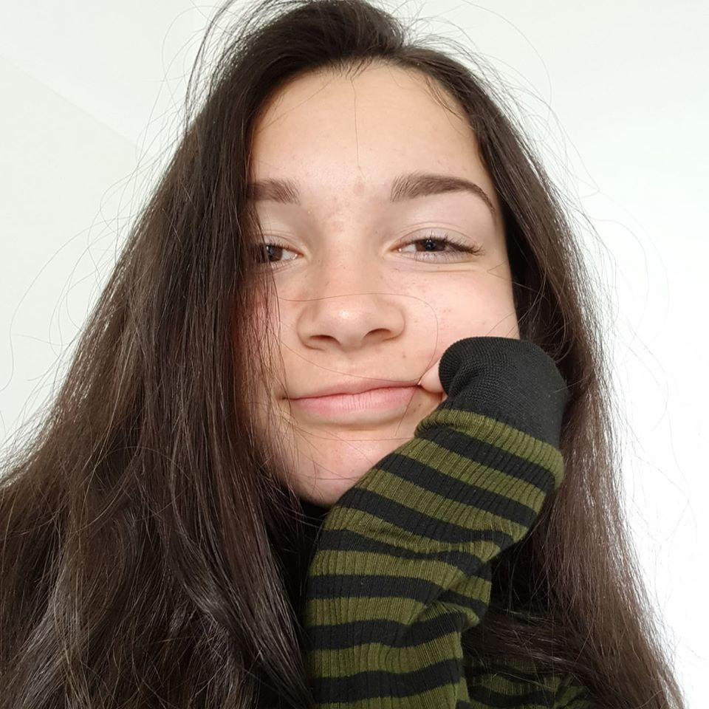
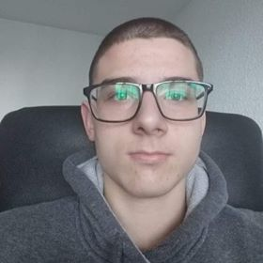
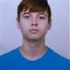
Team members
Zhenya Yordanova
Magdalena Omayska
Radsolav Stoychev
Ivan Ivanov

Slide 3






Used technologies

Slide 4
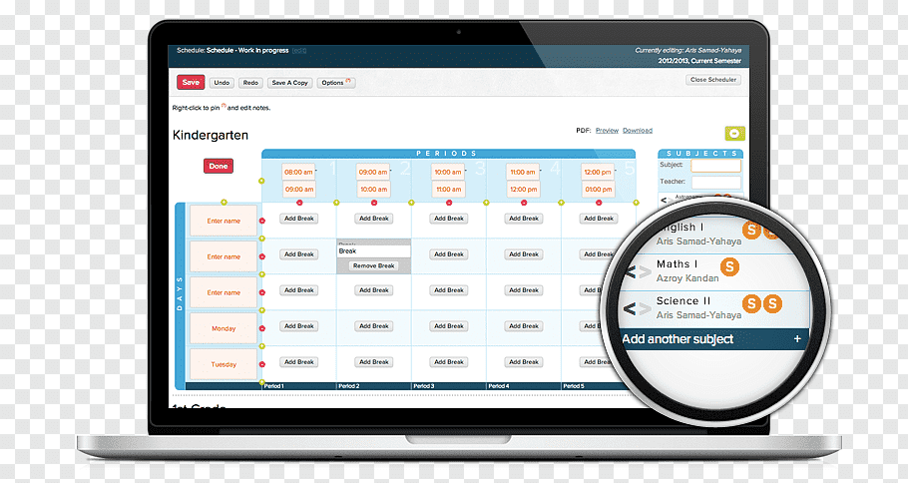
Short description
Our project is an application to help teachers organise students names, EGN and marks.

Slide 5
Future improvements
Display average grade of the term
Detects improvement or setback of the grades
Calculates the average grade by class
Shows the size of every class

Slide 6

THANK YOU FOR YOUR ATTENTION!

